Slide 1
INFINTE SERIES
SNEHA

Slide 2

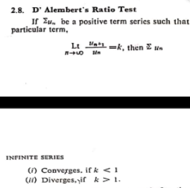




If k=1, test fails
Lim to infinity un;
if un!=0;
x>=1;divergent
x<1;convergent
Binomial expansion ka extension version, works for all powers, sometimes use this in infinte questions

Slide 3

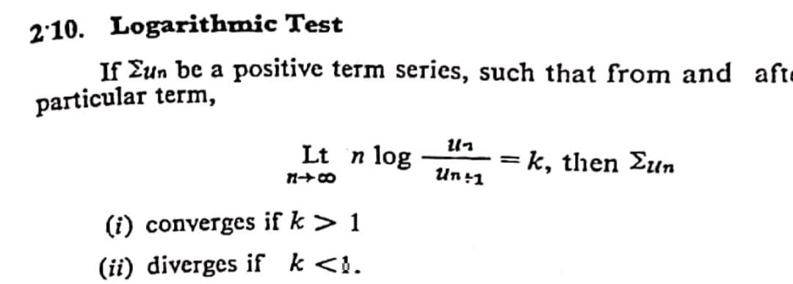
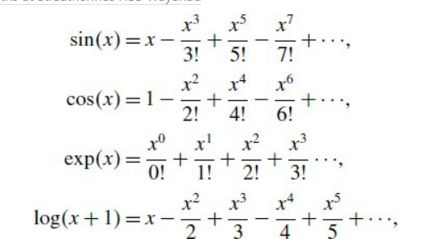

Un/vn=k
k=finite
if p<1, diverenget
p>1; convergent
Leibnitz test

Slide 4
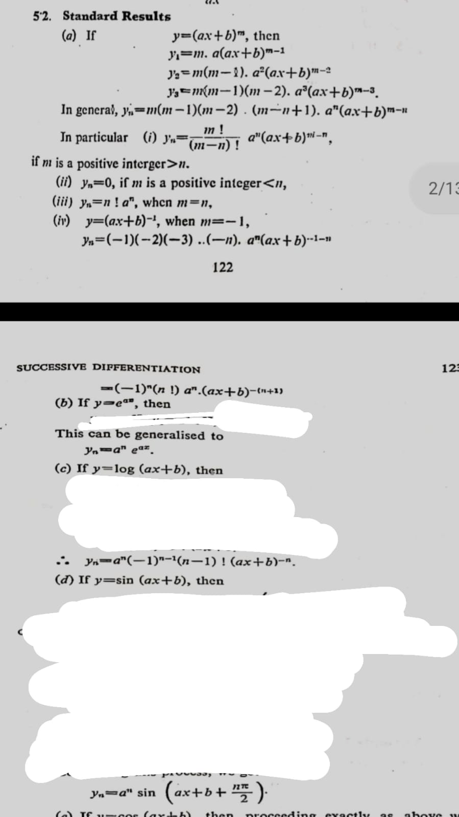
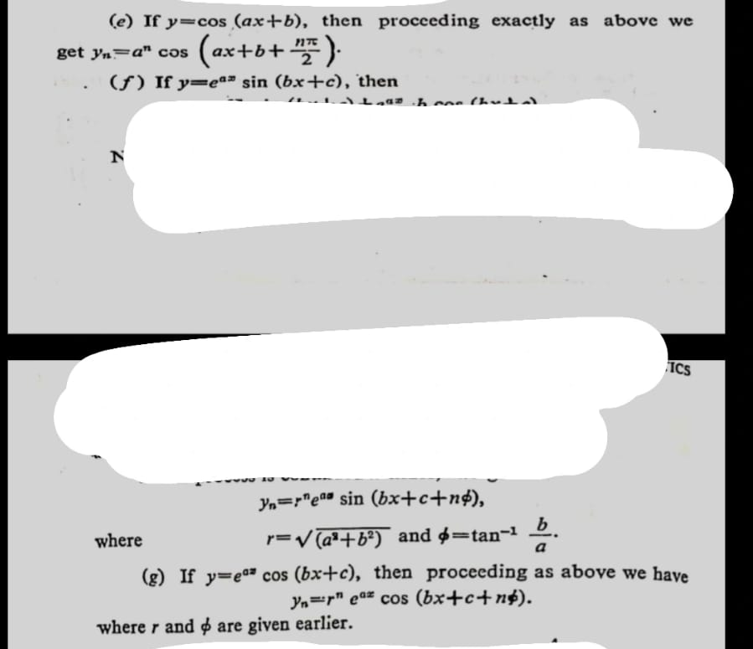

Slide 5


